Slide 1
Startup Success Prediction Using Machine Learning
BY
Govind Kumar
M.Sc. Mathematics and Scientific Computing
Roll No-194957
Under the Supervision of
Dr. Deepika Neela
NATIONAL INSTITUTE OF TECHNOLOGY
WARANGAL-506004
May 2020-21

Slide 2
Outline
Introduction
Model 1 :Logistic Regression
Model Evaluation
Model 2 :Random Forest
Example
Conclusion
References

Slide 3
Introduction:
Thousands of companies are emerging around the world each year. Among them, some are merged and acquired (M&A), or go to initial Public offering (IPO), while others may vanish and disappear. What makes this difference and leads to the different endings for each company?
How to predict the success of companies? If the investors can know how likely the company will achieve success given their current information, they can make a better decision on the investments. Therefore, in this project, given some key features of a company, we want to predict the probability of its success. More specifically, the input features are of two types: text features (such as industry category list and location) and numerical features (such as the amount of money a company already raised) then use Logistic Regression, Random Forest to output a predicted probability of success. Here I define the company success as the event that gives a large sum of money to the company’s founders, investors and early employees, specifically through a process of M&A (Merger and Acquisition) or an IPO (Initial Public Offering) . Finally, I use Accuracy and AUC score as the metric to compare the performance of these three models.

Slide 4
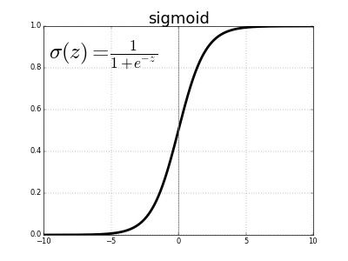
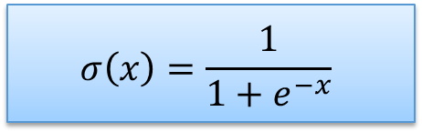
Model 1 : Logistic Regression
Logistic regression sometimes called the logistic model or logit model, analyses the relationship between multiple independent variables and a categorical dependent variable, and estimates the probability of occurrence of an event by fitting data to a logistic curve or sigmoid curve. Mathematical formula for sigmoid curve is given by
$$σ\left(x\right)=\frac{1}{1+e^{−x}}$$
Application of Logistic Regression:
Fraud detection: Detection of credit card frauds in banking .
Email spam or ham: Classifying the email as spam or ham
Disease (diabetes, cancer etc.) prediction: Predicting whether the patient has disease or not.
Lets see How this sigmoid curve predict whether the company will be successful or not ,By using the cost function of Logistic Regression

Slide 5
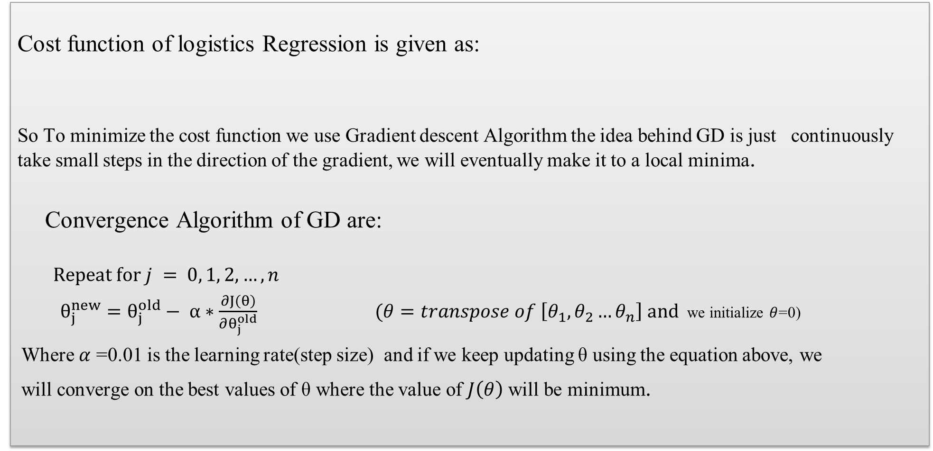
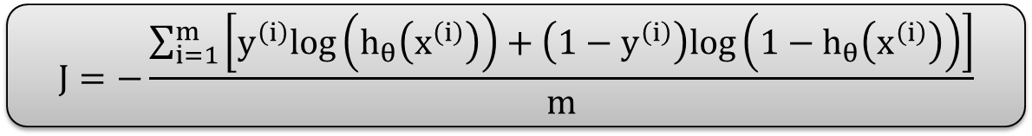
Logistic Regression(cont.):
Cost function of logistics Regression is given as:
So To minimize the cost function we use Gradient descent Algorithm the idea behind GD is just continuously
take small steps in the direction of the gradient, we will eventually make it to a local minima.
Convergence Algorithm of GD are:
$$Repeat for j = 0, 1, 2, …, n$$
$θ_{j}^{new}=θ_{j}^{old}− α∗\frac{∂J\left(θ\right)}{∂θ_{j}^{old}}$ $(θ=transpose of \left[θ_{1},θ_{2}…θ_{n}\right] and$we initialize $θ$=0)
Where $α$ =0.01 is the learning rate(step size) and if we keep updating θ using the equation above, we
will converge on the best values of θ where the value of $J\left(θ\right)$ will be minimum.
$$J=−\frac{\sum_{i=1}^{m}{\left[y^{\left(i\right)}log\left(h_{θ}\left(x^{\left(i\right)}\right)\right)+\left(1−y^{\left(i\right)}\right)log\left(1−h_{θ}\left(x^{\left(i\right)}\right)\right)\right]}}{m}$$

Slide 6
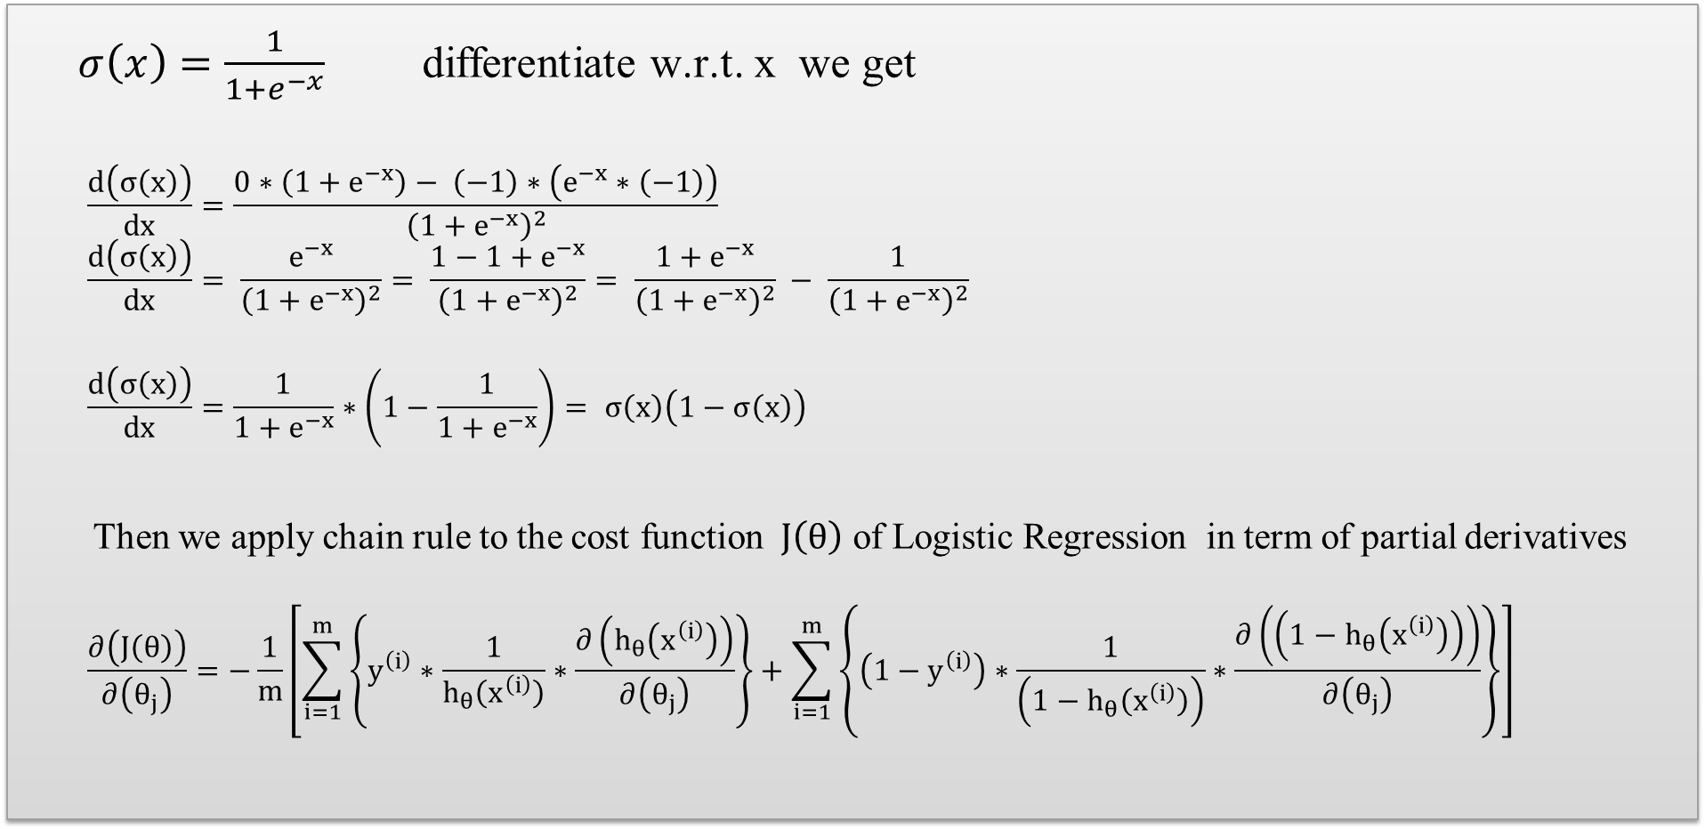
Optimization of cost function:
$σ\left(x\right)=\frac{1}{1+e^{−x}}$differentiate w.r.t. x we get
$$\frac{d\left(σ\left(x\right)\right)}{dx}=\frac{0∗\left(1+e^{−x}\right)− \left(−1\right)∗\left(e^{−x}∗\left(−1\right)\right)}{{\left(1+e^{−x}\right)}^{2}}$$
$$\frac{d\left(σ\left(x\right)\right)}{dx}= \frac{e^{−x}}{{\left(1+e^{−x}\right)}^{2}}= \frac{1−1+e^{−x}}{{\left(1+e^{−x}\right)}^{2}}= \frac{1+e^{−x}}{{\left(1+e^{−x}\right)}^{2}} − \frac{1}{{\left(1+e^{−x}\right)}^{2}}$$
$$\frac{d\left(σ\left(x\right)\right)}{dx}=\frac{1}{1+e^{−x}}∗\left(1−\frac{1}{1+e^{−x}}\right)= σ\left(x\right)\left(1−σ\left(x\right)\right)$$
Then we apply chain rule to the cost function $J\left(θ\right)$ of Logistic Regression in term of partial derivatives
$$\frac{∂\left(J\left(θ\right)\right)}{∂\left(θ_{j}\right)}=−\frac{1}{m}\left[\sum_{i=1}^{m}{\left\{y^{\left(i\right)}∗\frac{1}{h_{θ}\left(x^{\left(i\right)}\right)}∗\frac{∂\left(h_{θ}\left(x^{\left(i\right)}\right)\right)}{∂\left(θ_{j}\right)}\right\}+\sum_{i=1}^{m}{\left\{\left(1−y^{\left(i\right)}\right)∗\frac{1}{\left(1−h_{θ}\left(x^{\left(i\right)}\right)\right)}∗\frac{∂\left(\left(1−h_{θ}\left(x^{\left(i\right)}\right)\right)\right)}{∂\left(θ_{j}\right)}\right\}}}\right]$$

Slide 7
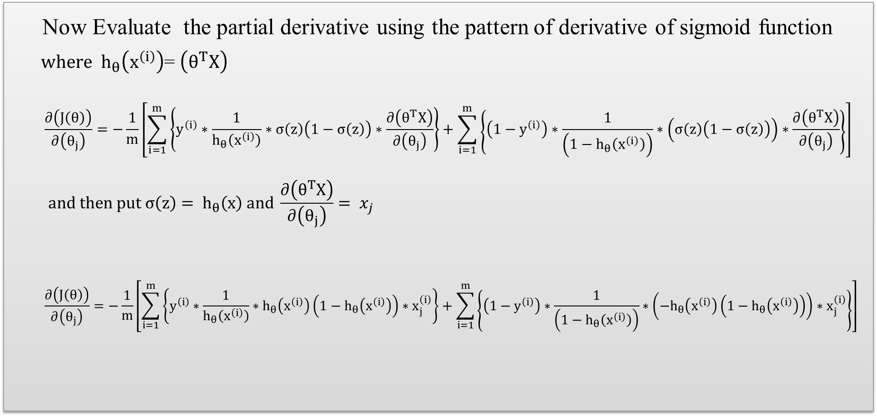
Optimization of cost function(cont.):
Now Evaluate the partial derivative using the pattern of derivative of sigmoid function
${ where h}_{θ}\left(x^{\left(i\right)}\right)$= $\left(θ^{T}X\right)$
$$\frac{∂\left(J\left(θ\right)\right)}{∂\left(θ_{j}\right)}=−\frac{1}{m}\left[\sum_{i=1}^{m}{\left\{y^{\left(i\right)}∗\frac{1}{h_{θ}\left(x^{\left(i\right)}\right)}∗σ\left(z\right)\left(1−σ\left(z\right)\right)∗\frac{∂\left(θ^{T}X\right)}{∂\left(θ_{j}\right)}\right\}+\sum_{i=1}^{m}{\left\{\left(1−y^{\left(i\right)}\right)∗\frac{1}{\left(1−h_{θ}\left(x^{\left(i\right)}\right)\right)}∗\left(σ\left(z\right)\left(1−σ\left(z\right)\right)\right)∗\frac{∂\left(θ^{T}X\right)}{∂\left(θ_{j}\right)}\right\}}}\right]$$
$$and then put σ\left(z\right)= h_{θ}\left(x\right) and \frac{∂\left(θ^{T}X\right)}{∂\left(θ_{j}\right)}= x_{j}$$
$$\frac{∂\left(J\left(θ\right)\right)}{∂\left(θ_{j}\right)}=−\frac{1}{m}\left[\sum_{i=1}^{m}{\left\{y^{\left(i\right)}∗\frac{1}{h_{θ}\left(x^{\left(i\right)}\right)}∗h_{θ}\left(x^{\left(i\right)}\right)\left(1−h_{θ}\left(x^{\left(i\right)}\right)\right)∗x_{j}^{\left(i\right)}\right\}+\sum_{i=1}^{m}{\left\{\left(1−y^{\left(i\right)}\right)∗\frac{1}{\left(1−h_{θ}\left(x^{\left(i\right)}\right)\right)}∗\left(−h_{θ}\left(x^{\left(i\right)}\right)\left(1−h_{θ}\left(x^{\left(i\right)}\right)\right)\right)∗x_{j}^{\left(i\right)}\right\}}}\right]$$

Slide 8
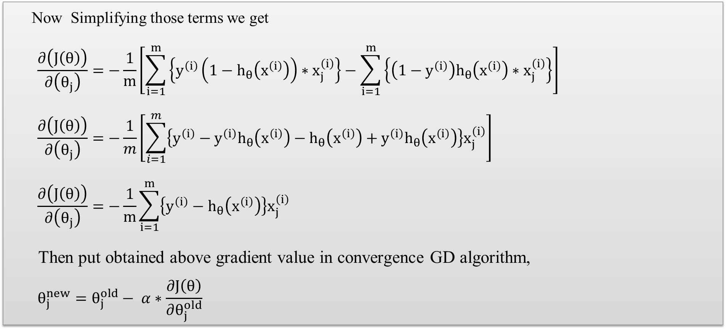
Optimization of cost function(cont.):
Now Simplifying those terms we get
$$\frac{∂\left(J\left(θ\right)\right)}{∂\left(θ_{j}\right)}=−\frac{1}{m}\left[\sum_{i=1}^{m}{\left\{y^{\left(i\right)}\left(1−h_{θ}\left(x^{\left(i\right)}\right)\right)∗x_{j}^{\left(i\right)}\right\}−\sum_{i=1}^{m}{\left\{\left(1−y^{\left(i\right)}\right)h_{θ}\left(x^{\left(i\right)}\right)∗x_{j}^{\left(i\right)}\right\}}}\right]$$
$$\frac{∂\left(J\left(θ\right)\right)}{∂\left(θ_{j}\right)}=−\frac{1}{m}\left[\sum_{i=1}^{m}{\left\{y^{\left(i\right)}−{y^{\left(i\right)}h}_{θ}\left(x^{\left(i\right)}\right)−h_{θ}\left(x^{\left(i\right)}\right)+{y^{\left(i\right)}h}_{θ}\left(x^{\left(i\right)}\right)\right\}x_{j}^{\left(i\right)}}\right]$$
$$\frac{∂\left(J\left(θ\right)\right)}{∂\left(θ_{j}\right)}=−\frac{1}{m}\sum_{i=1}^{m}{\left\{y^{\left(i\right)}−h_{θ}\left(x^{\left(i\right)}\right)\right\}x_{j}^{\left(i\right)}}$$
Then put obtained above gradient value in convergence GD algorithm,
$$θ_{j}^{new}=θ_{j}^{old}− α∗\frac{∂J\left(θ\right)}{∂θ_{j}^{old}}$$

Slide 9
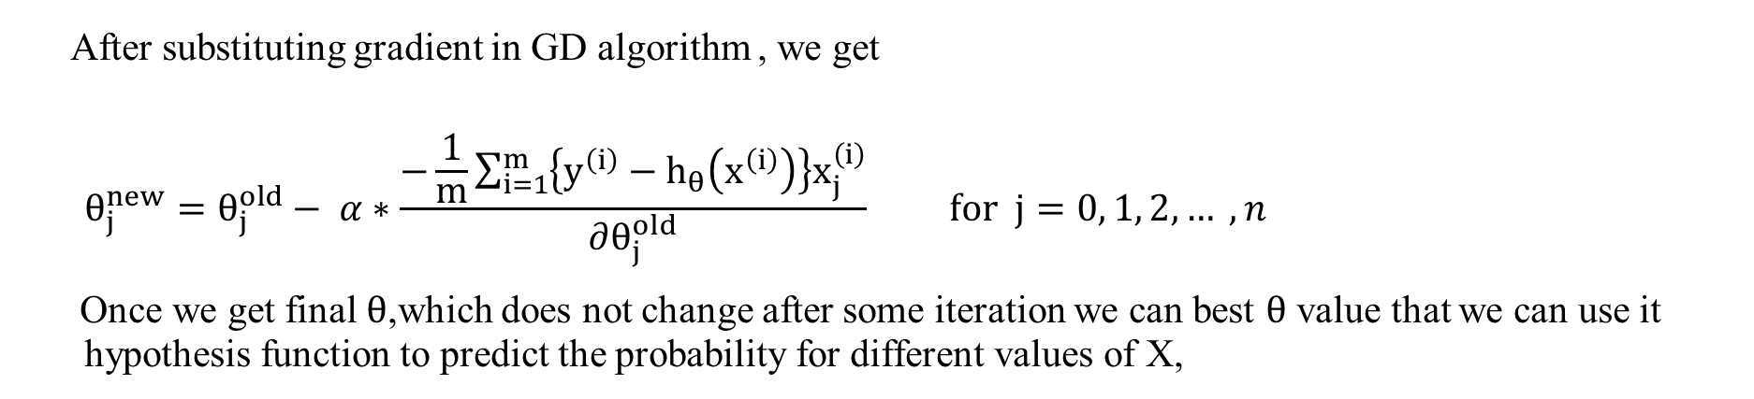
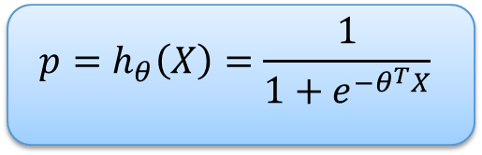
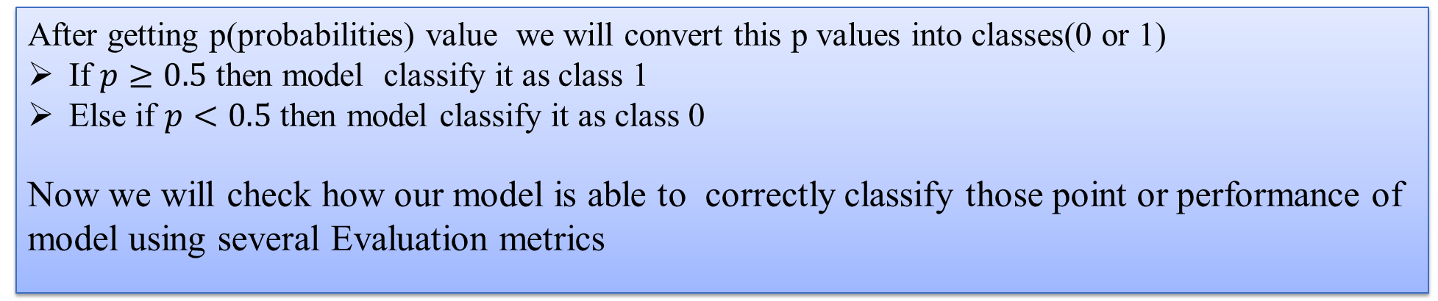
Optimization of cost function(cont.):
After substituting gradient in GD algorithm , we get
$$θ_{j}^{new}=θ_{j}^{old}− α∗\frac{−\frac{1}{m}\sum_{i=1}^{m}{\left\{y^{\left(i\right)}−h_{θ}\left(x^{\left(i\right)}\right)\right\}x_{j}^{\left(i\right)}}}{∂θ_{j}^{old}} for j=0, 1, 2, … ,n$$
Once we get final$θ$,which does not change after some iteration we can best $θ$ value that we can use it hypothesis function to predict the probability for different values of X,
$${p=h}_{θ}\left(X\right)=\frac{1}{1+e^{−θ^{T}X}}$$
After getting p(probabilities) value we will convert this p values into classes(0 or 1)
If $p≥0.5$ then model classify it as class 1
Else if $p<0.5$ then model classify it as class 0
Now we will check how our model is able to correctly classify those point or performance of model using several Evaluation metrics

Slide 10
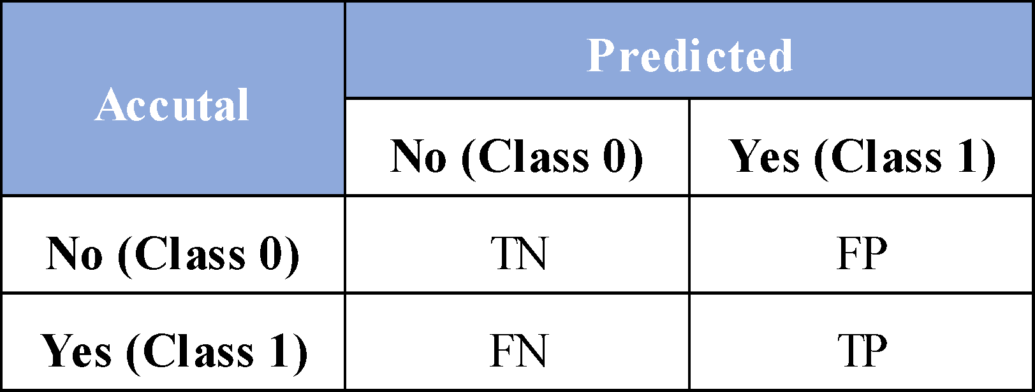
Evaluation Metrics:
Confusion Metrics:
In a confusion matrix, we describe the performance of a classification model. Each row of the matrix represents the instances in a predicted class while each column represents the instances in an actual class (vice versa). There are four basic terms in a confusion matrix:
TP (true positive): an outcome where the model correctly predicts the positive class.
TN (true negative): an outcome where the model correctly predicts the negative class.
FP (false positive): an outcome where the model incorrectly predicts the positive class.
FN (false negative): an outcome where the model incorrectly predicts the negative class.
Evaluation Matrix we use as follows:
Accuracy
True Positive Rate(TPR)
False Positive Rate(FPR)
F1 Score
AUC-Score

Slide 11
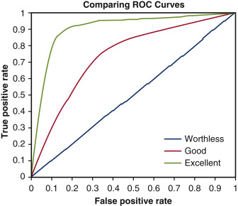


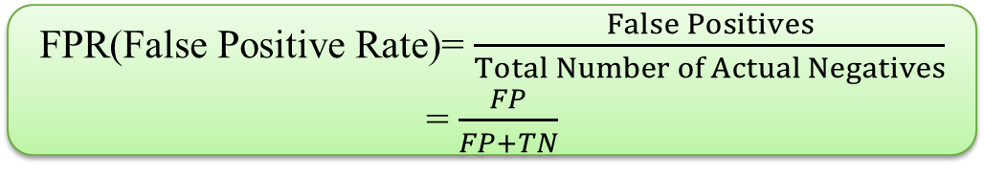
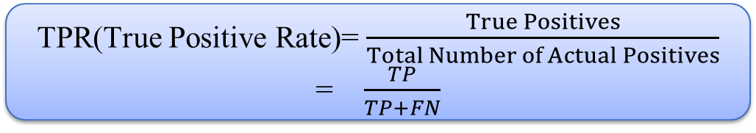
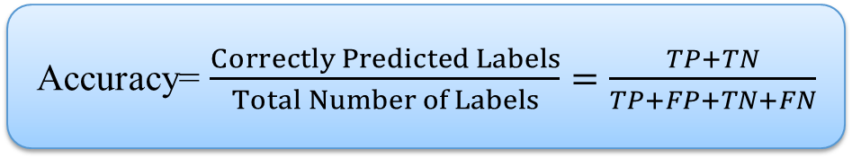
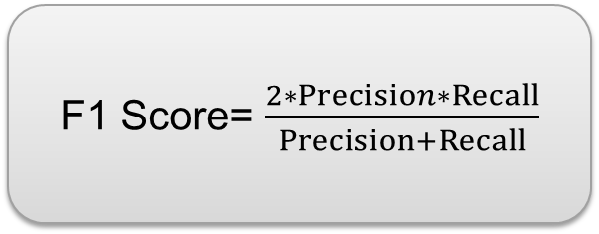
Accuracy= $\frac{Correctly Predicted Labels}{Total Number of Labels}=\frac{TP+TN}{TP+FP+TN+FN}$
TPR(True Positive Rate)= $\frac{True Positives}{Total Number of Actual Positives}$ = $\frac{TP}{TP+FN}$
Precision = $\frac{TP}{TP+FP}$
Recall = $\frac{TP}{TP+FN}$
FPR(False Positive Rate)= $\frac{False Positives}{Total Number of Actual Negatives}$ = $\frac{FP}{FP+TN}$
Receiver Operating Characteristic (ROC) Curve:
ROC is a probability curve and AUC(Area Under curve) represents the degree or measure of separability. It tells how much the model is capable of distinguishing between classes. Higher the AUC, the better the model is at predicting 0s as 0s and 1s as 1s.
This graph gives us AUC score
F1 Score= $\frac{2∗Precision∗Recall}{Precision+Recall}$

Slide 12
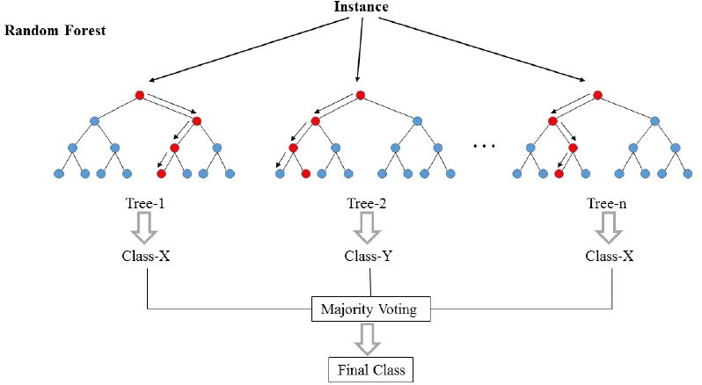
Model 2:Random Forest
Random forests or random decision forests are an ensemble learning method for classification , regression and other tasks that operates by constructing a multitude of decision trees at training time and outputting the class that is the mode of the classes (classification) or mean/average prediction of the individual trees
The Working process can be explained in the below steps and diagram:
Step-1: Select random K data points from the training set.
Step-2: Build the decision trees associated with the selected data
points (Subsets).
Step-3: Choose the number N(no. of DT) for decision trees that
you want to build.
Step-4: Repeat Step 1 & 2.
Step-5: For new data points, find the predictions of each decision tree,
and assign the new data points to the category that wins the majority
votes
For building decision Tree and how model decide to split those trees it’s uses terms like Entropy and Information Gain because Entropy and information gain are the building blocks of decision trees.

Slide 13

Random Forest(Cont.):
Entropy: Entropy is a measure of the randomness of a system or it is a metric for calculating uncertainty
Where p(x) is the probabilty of getting x from the data and S is Subset of dataset.
Information Gain: The information gain is the amount by which the Entropy of the system reduces due to the split that we have done
Application of Random Forest:
Banking: predict whether creditworthiness of loan applicant or not
Healthcare: Patients are diagnosed by assessing their previous medical history
Stock market : For predicting the behavior of stocks
Entropy E(S)= -∑p(x)*log₂(p(x))

Slide 14
Problem statement:
Example
We are going to work on Crunchbase dataset where using the past information we build some model and predict where the individual company will be successful or not successful.
The problem is Binary classification problem its means1 for successful and 0 for not successful
By this case study Investors can know how likely the company will achieve success given their current information, they can make a better decision on their investments.
We use Two classification algorithm as we have discussed previously for this case study
The whole code is written using Python language in Jupyter Notebook which is open source web applications.

Slide 15
Project life cycle:
Importing library
loading dataset
Data preparation
Feature Engineering & Feature Scaling
Model Building
Splitting dataset
Model Evaluation
Model Interpretation
Conclusion

Slide 16
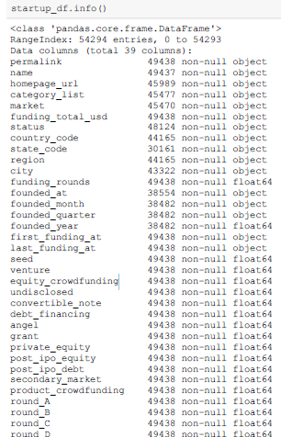
Dataset overview :
The Dataset used is from Crunchbase in csv format of which the data are worldwide startup companies recorded from 1902 until 2014. It is consisted of 54,294 entries(rows) With 39 attributes of various data types between object and float as shown below.
Dataset description

Slide 17
Data preparation:
Initially before doing machine learning we are seeing dataset thoroughly regarding its datatype whether they are appropriate or not and by then we know what kind of data cleaning should be taken to proceed before go into ML.
Data cleaning : Since the dataset is quite messy with formatting ,labelling header , quite a lot involving missing values ,and the dataset are also dispersed to introduce outliers So in this project the data wrenching which have been taken are:
Fixing spacing format in header such as ‘market’ and ‘funding_total_usd’.
Remove 4855 row duplicates values.
Tackling uncommon format i.e. Attribute ’funding_total_used’ involved string format with wrongly used comma as separator (‘32,333’) then we eliminate the comma and change the data type into numeric.
Handling missing values as there are categorical variable in dataset so we adjust the missing values with appropriate data as follows:
Replacing missing values in ‘market’ with ‘other’
Replacing missing value in ‘funding_total_usd’ with 0
Replacing missing value in ‘country_code’ with ‘other’
Replacing missing value in ‘region’ with ‘other’
Replacing missing value in ‘founded_year’ with mean from this column
5. Add Target Variable whether each company becomes successful (1) or not successful(0).

Slide 18
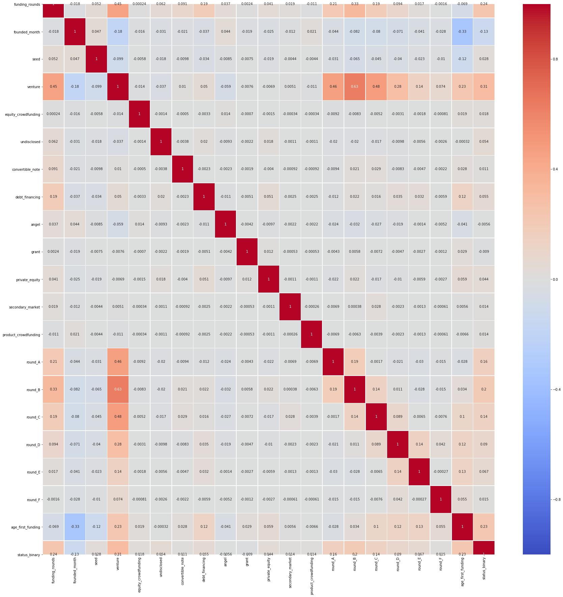
Feature Engineering:
In this section we use data handling such as Object data type into numeric by Label encoding as follows:
Label encoding for categorical attributes of ‘status’,’market’,’country_code’,’region’ By using label encoding.
Change attributes ‘founded_at’ to be ‘founded_year’ since inconsistent data between both year is found then drop “founded_at’ column.
Then we use min max Scaler to normalize
the data
After doing data wrenching or often being
called as data preprocessing we conduct the
correlation between attributes with results as
follows in given diagram.
The most correlated attributes are status,
founded year , funding round, Post equity,
so on as so forth (dark violet colour are
most correlated)

Slide 19
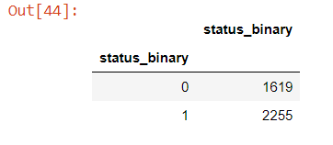
Data splitting:
Then check how skewed the target variable of dataset and found unbalanced target variable is obtained, where ‘0’ for non-successful and ‘1’For successful companies from the dataset
To tackle this unbalanced dataset we use SMOTE (Synthetic Minority Over-sampling Technique) to balance this dataset so that we do not need to up-sample dataset nor diminishing dataset .
Subsequently we do Training and Test Splitting with proportion 67% : 33% of whole dataset
Now we are ready to apply Both classification algorithm that we have discussed previously and see How good they work on the dataset

Slide 20
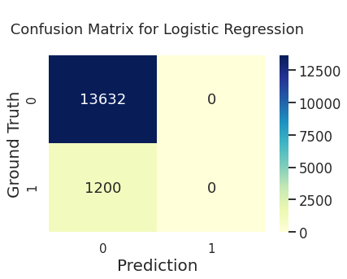
Using Logistic regression:
After performing logistic regression we look ROC curve it’s look very good and AUC score is around 0.50 which is not very good score and using confusion matrix of LR we got model result
Model evaluation:
Accuracy : 91%
Precision : 0
Recall : 0
F1_score : 0
AUC : 0.50
It can be seen from confusion matrix of Logistic Regression it is only good for the non successful companies and can’t predict the successful companies

Slide 21
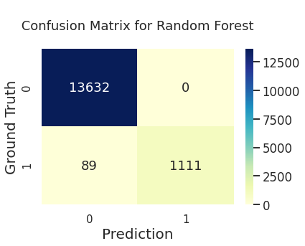
Using Random forest:
After performing on RF we got AUC of 0.96 which is better than Logistic Regression and using Random forest Confusion matrix we got model result.
Model evaluation:
Accuracy : 98%
Precision : 1.0
Recall : 0.92
F1_score : 0.96
AUC : 0.96
By comparing with previous model Random Forest performed very well and not biased with 0 or 1 as shown in confusion matrix. So Random forest model can be considered as best model for Deployment for prediction of success of startup

Slide 22
Model Interpretation:
Logistic Regression model is only good for non successful companies because it is not able to predict the successful companies.
Logistic Regression could not be good model in the dataset because the way they work is highly rely on decision boundary.
Sigmoid function as loss function cannot be used to differentiate the datapoints in the dataset given ,since its located in a very small rigid position that sometimes overlap .
Random forest successfully builds random trees from the sub sample feature of the dataset.
Random decision forests correct the decision trees habit of overfitting to their training set by seeing confusion Matrix of RF.

Slide 23
Conclusion:
To predict business success we built ML models and compared the performance of two algorithms : logistic regression , Random forest .we were able to increase the recall ,F1 score and AUC score as compared to initial Model. The Random forest model the highest value of Precision, Recall and F1 score out of tested algorithms which is best model
Random forest performed with higher precision than recall its means that they are able to find companies that fit the most popular patterns of Success
Country with fiscal policy ,investment in innovation and its creation of a system supporting the education of new technologies increase the number of startup examples are Estonia and Israel would like to increase the impact of new technologies .
We have also seen that most popular startup industries such as software and Internet services are not the ones with highest share of successful Companies but companies operating Healthcare and manufacturing domain have also highest chances of success but because of some barrier Chances are very lower for success.

Slide 24
References:
Applied ai Machine learning Course By Srikanth Verma Chekuri.
Francisco Ramadas da Silva Ribeiro Bento. Predicting start-up success with machine learning. PhD thesis, 2018.
Andrew Ng (CEO/Founder Landing AI), CS229 Machine Learning Online course by Stanford University from Coursera.
Liang E. & Daphne Yuan S.T. Paper (2012).Investors are Social Animals: Predicting Investor Behavior using
Social Network Features via Supervised Learning Approach
Ravisankar, P. Ravi, V. Raghava Rao, G., & Bose, I. (2011). Detection of financial statement fraud and feature
Selection using data mining techniques.

Slide 25
Thank You…

